Slide 1

CAR INSURANCE DATABASE
UNDER THE GUIDANCE OF : Dr. Uma Sheshadri Ph.D.
DONE BY:
RAGHU PRASAD J N (18BCS073) ; ARUN AVK (18BCS012) ; DHANUSH KUMAR R (18BCS071) ; NISHEER V (18BCS061) NAVEEN DEVANG R(18BCS072) ; VIVEK SURESH (18BCS111) ; PALSHINI B (18BCS062) ; PAVAN KUMAR N (18BCS064) ; AQTAR PARVEEZ (18BCS010).

Slide 2
VEHICLE INSURANCE
Vehicle insurance is insurance purchased for cars, trucks, and other vehicles. Its primary use is to provide protection against losses incurred as a result of traffic accidents and against liability that could be incurred in an accident.
Vehicle insurance protects you against financial loss if you have an accident. It is a contract between you and the insurance company. You agree to pay the premium and the insurance company agrees to pay your losses as defined in your policy.

Slide 3
THIRD PARTY INSURANCE
It is a punishable offence to use the vehicle without insurance ' Necessary provisions for its enforcement are therefore available with the authorities: failure to comply the provisions of sec.146 of the mv act is punishable by an imprisonment of three months or a penalty of Rs 1000 or both
LIABILITY TO THIRD PARTIES
Death of or bodily injury to any person including occupants as per motor vehicles act, 1988. ' Damage to property other than property belonging to the insured or held in trust/ custody or control of the insured All costs and expenses incurred with its written consent. ' Any driver who is driving the vehicle on the insured's order or with insured's permission Observes & fulfill the terms exceptions and conditions of this policy

Slide 4
TYPES OF VEHICLE INSURANCE
Private car insurance: It is the fastest growing sector as it is compulsory for all the new cars. The amount of premium depends on the make and value of the car, state where the car is registered and the year of manufacture.
Two wheeler insurance: It covers accidental insurance for the drivers of the vehicle. The amount of premium depends on the current showroom price multiplied by the depreciation rate fixed by the Tariff Advisory Committee at the time of the beginning of policy period.
Commercial vehicle insurance: It provides cover for all the vehicles which are not used for personal purposes, like the Trucks and HMVs. The amount of premium depends on the showroom price of the vehicle at the commencement of the insurance period, make of the vehicle and the place of registration of the vehicle.

Slide 5
INSURANCE COVERAGE
Bodily injury- It offers cover for any bodily injury incurred from an accident where the insured car was involved
Damage- It offers cover for the damage incurred to the car either due to an accident, theft or certain natural calamities
Third party property damage- It pays up for the damage incurred by a third party vehicle involved in an accident with the insured vehicle
Death- It also offers cover for the death of the driver/ passengers present in the insured vehicle at the time of accident or calamity

Slide 6
TYPES OF POLICIES
Motor insurance Liability cover : la. Third party death or bodily injury. 1b. Third party property damage. 2a.PersonaI Accident cover to owner/ driver death. 2b.PersonaI accident cover to owner/ driver injury. 2c. Total compensation not to exceed 1 Iakh in two wheelers and 2 Iakh in case of other vehicles. (exclusions as per pa policy)
Motor insurance Comprehensive policy: includes the below in addition to liability only policy covers: a. Fire, Explosion, Self ignition, Lightening. b. Burglary, housebreaking or theft. c. By riot and strike. d. By Earthquake. e. BV flood, typhoon, hurricane storm, tempest, cyclone, hail storm, frost. inundation, f. By accidental external means. g. By malicious act. h. By terrorist activity. i. While in transit by road, rail, inland water way, elevator or air.

Slide 7
CLAIM SETTLEMENT
Car Insurance Claim is the process under which a car insurance policyholders requests the insurer to compensate for the expenses/damage incurred by him/her due to an unfortunate event involving his/her car.
1) Cashless Claim
If you get your car repaired at a garage authorized by the insurer then you enter a cashless claim settlement process. As the name suggests, under this type of claim the entire process is cashless which means that the policyholder is not required to pay any cash/money to the insurer authorized garage for the repair of his/her car.
2) Reimbursement Claim
When you get your car repaired at a garage/workshop outside the authorized network of the insurer, you enter a reimbursement claim settlement process. Under this process, the policyholder makes the payment for the repair cost at the garage of his/her choice and gets the repair cost reimbursed from the insurer later subject to the claim amount.

Slide 8
NEED FOR OUR PROJECT
Globally motor insurance is the biggest and fastest growing general insurance portfolio and India is no exception to it. ' It accounts for more than 45% of the total general insurance premium income in India. ' In the year ending 2016, total nonlife premium of the industry was about 28,000 crores out of which motor share was about 13,000 crores, ' However motor insurance business was 25 crores only at the time of nationalization
About 300 persons are being killed on road accidents daily and about are being injured annually and The incidence of road accidents to number of vehicles in India is alarmingly high in comparison to developed countries: The number of road accidents per 10,000 vehicles in India is about 120 as against 10 in the developed countries of the world The number of deaths per 10,000 vehicles in India is 55 as against 2 in the west. ' In 1990, traffic accidents were world's ninth biggest cause of death and it is expected to become the third biggest by 2020. Study undertaken by the 'world health organization' reveals that road accidents are the second and third biggest cause of death in the age group of 5-29 and 30- 44 yrs. Respectively. The Indian situation is amongst the worst in the world i.e. Share of road fatalities is around 86%. Against 40% share of vehicle population.

Slide 9
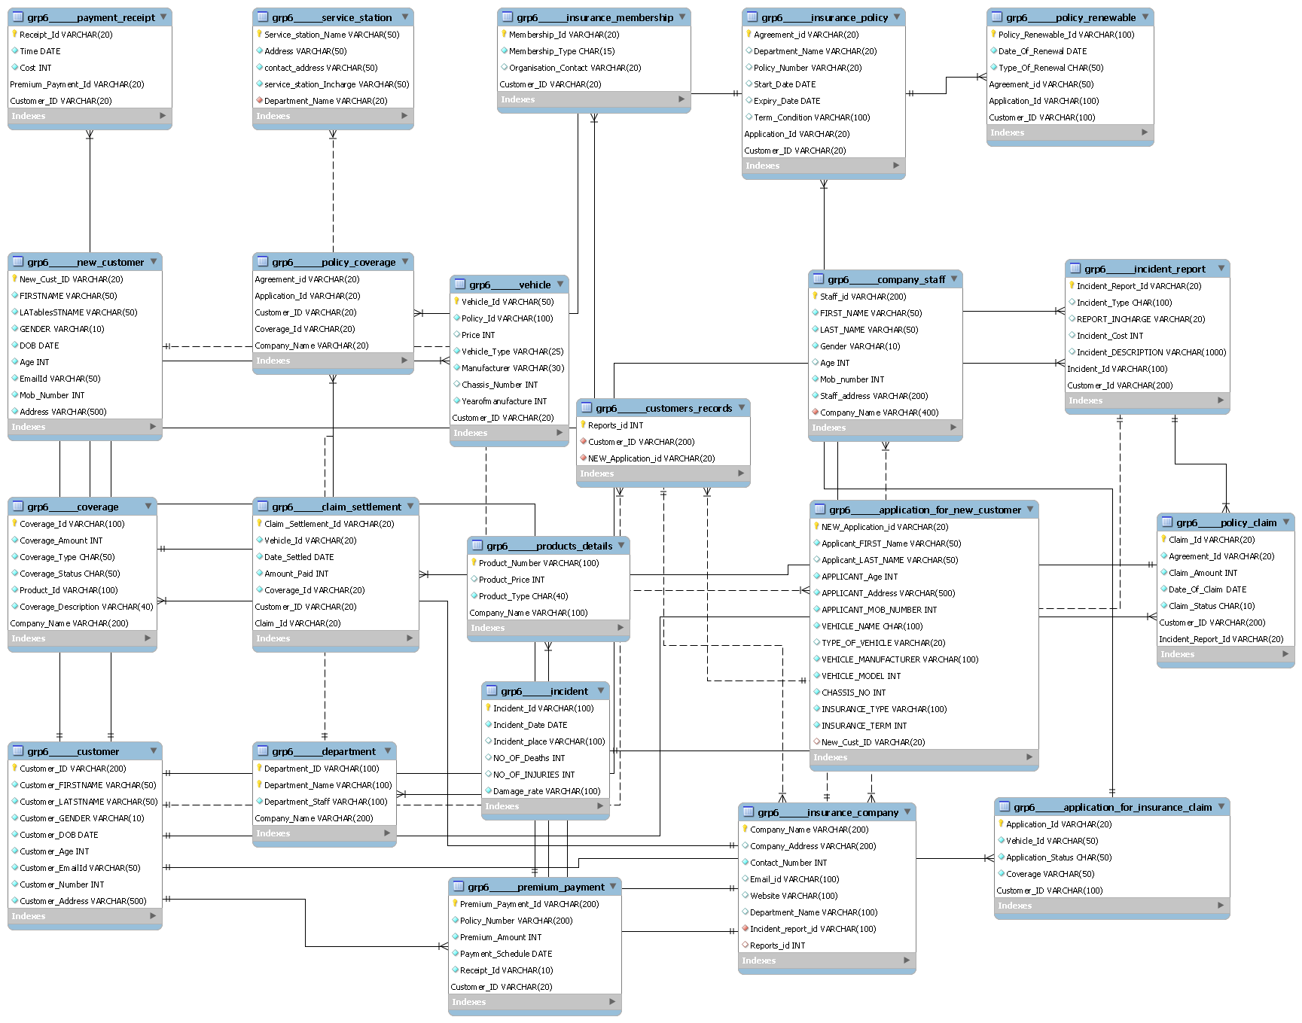
E R DIAGRAM

Slide 10
NOTED ENTTITIES
PAYMENT RECEIPT
GETTING THE PAYMENT DETAILS TO VALIDATE THE EXPENSES.
SERVICE STATION
DETAILS OF THE SERVICE STATION IS BEING COLLECTED.
INSURANCE MEMBERSHIP
GETTING THE DETAILS OF THEIR MEMBERSHIP.
INSURANCE POLICY
TO LOOK INTO VALIDITY AND TERMS FOR CLAIM.
POLICY RENEWABLE
REGARDING THE RENEWAL OF THE INSURANCE POLICY
NEW CUSTOMER
GETTING THE DATA OF CUSTOMERS.

Slide 11
POLICY COVERAGE
CONTAINS AGREEMENT ID , COVERAGE ID , COMPANY NAME , CUSTOMER ID AND APPLICATION ID.
VEHICLE
CONTAINS VEHICLE ID , POLICY ID , VEHICLE TYPE , PRICE , YEAR OF MANUFACTURE , MANUFACTURER ,CHASIS NO & CUSTOMER ID.
CUSTOMERS RECORDS
CONTAINS REPORT ID , CUSTOMER ID & NEW APPLICATION ID.
COMPANY STAFF
CONTAINS STAFF ID , FIRST NAME , LAST NAME ,GENDER , AGE , MOBILE NUMBER , ADDRESS & CONPANY NAME.
INCIDENT REPORT
CONTAINS INCIDENT REPORT ID , INCIDENT TYPE , REPORT INCHARGE , INCIDENT COST , INCIDENT DESCRIPTION , INCIDENT ID & CUSTOMER ID.
COVERAGE
CONTAINS COVERAGE ID , TYPE , AMOUNT , STATUS , PRODUCT ID , COVERAGE DESCRIPTION & COMPANY NAME.

Slide 12
CLAIM SETTLEMENT
CONTAINS SETTLEMENT ID , VEHICLE ID , SETTLED DATE , AMOUNT PAID , COVERAGE ID , CUSTOMER ID AND CLAIM ID.
PRODUCT DETAILS
CONTAINS PRODUCT NUMBER , PRICE , TYPE AND COMPANY NAME.
APPLICATION FOR NEW CUSTOMER
CONTAINS APPLICANT’S DETAILS LIKE FIRST NAME , LAST NAME , GENDER , AGE , ADDRESS , MOBILE NUMBER , VEHICLE NAME , VEHICLE MANUFACTURER AND MODEL , CHASIS NO , INSURANCE TYPE , INSURANCE TERM AND GENERATED CUSTOMER ID.
POLICY CLAIM
CONTAINS CLAIM ID , AGREEMENT ID , CLAIM AMOUNT , DATE OF CLAIM ,CLAIM STATUS , CUSTOMER ID , INCIDENT REPORT ID.
CUSTOMER
CONTAINS CUSTOMER ID , FIRSTNAME , LASTNAME , GENDER , D.O.B , AGE ,EMAIL ID , CONTACT NUMBER , CUSTOMER ADDRESS.
DEPARTMENT
CONTAINS DEPARTMENT ID , NAME , STAFF NAME & COMPANY NAME.

Slide 13
INCIDENT
CONTAINS INCIDENT ID , DATE , PLACE , NO.OF DEATHS , INJURIES AND DAMAGE RATE.
INSURANCE COMPANY
CONTAINS COMPANY NAME , ADDRESS ,CONTACT NUMBER , EMAIL , WEBSITE , DEPARTMENT NAME , REPORT ID .
APPLICATION FOR INSURANCE CLAIM
CONTAINS APPLICATION ID , VEHICLE ID COVERAGE AND CUSTOMER ID.
PREMIUM PAYMENT
CONTAINS POLICY NUMBER , ID , PREMIUM AMOUNT , SCHEDULE AND RECEIPT.

Slide 14
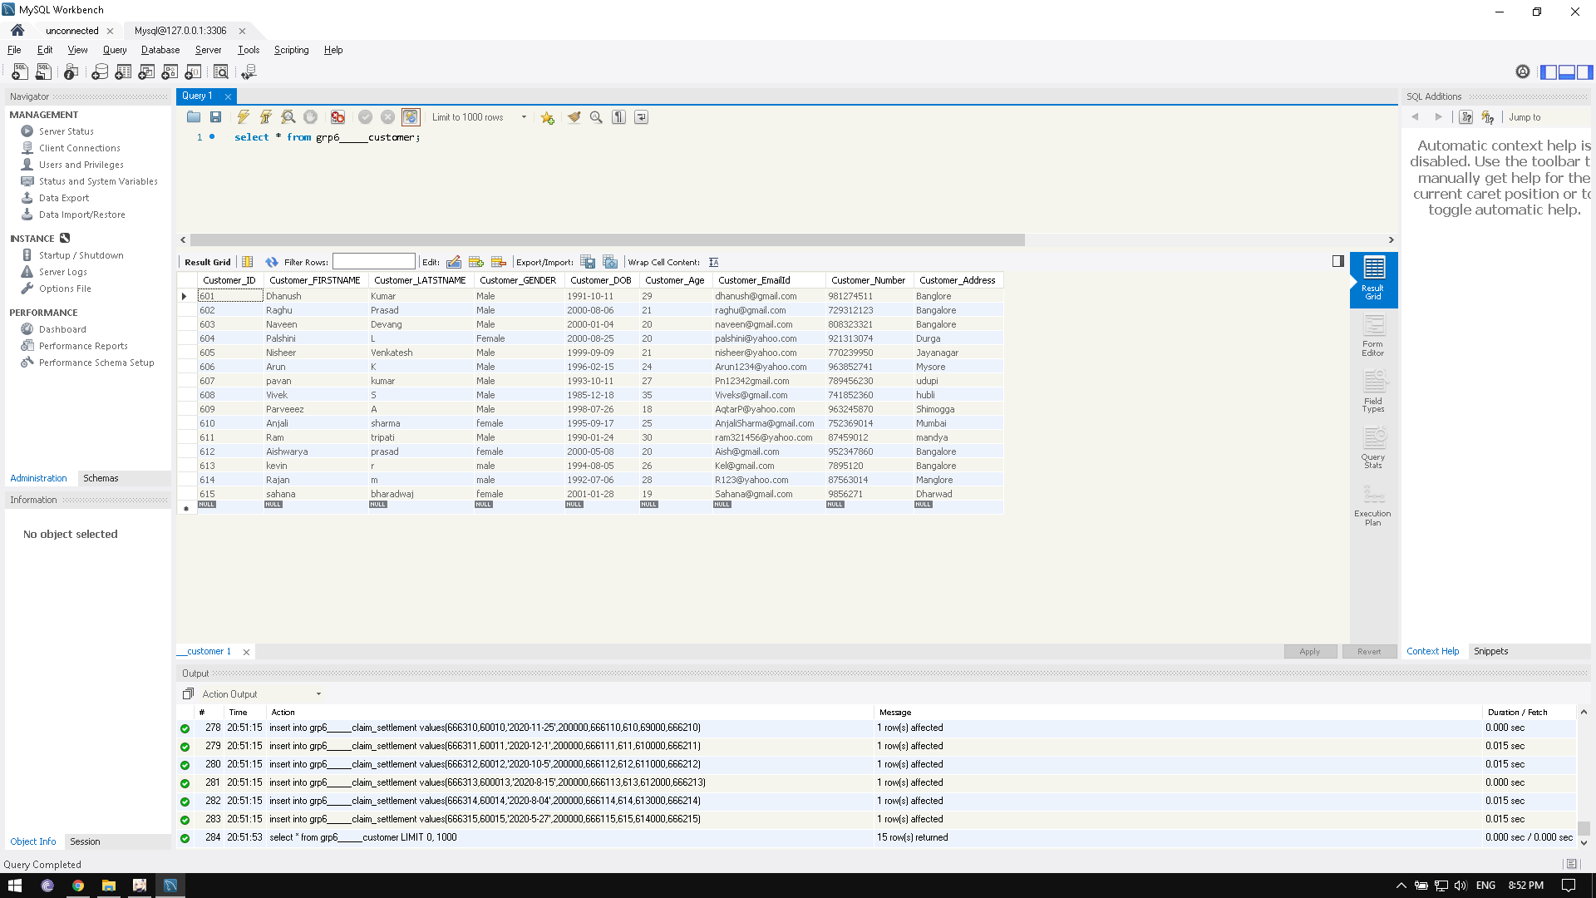
CUSTOMER DATABASE

Slide 15
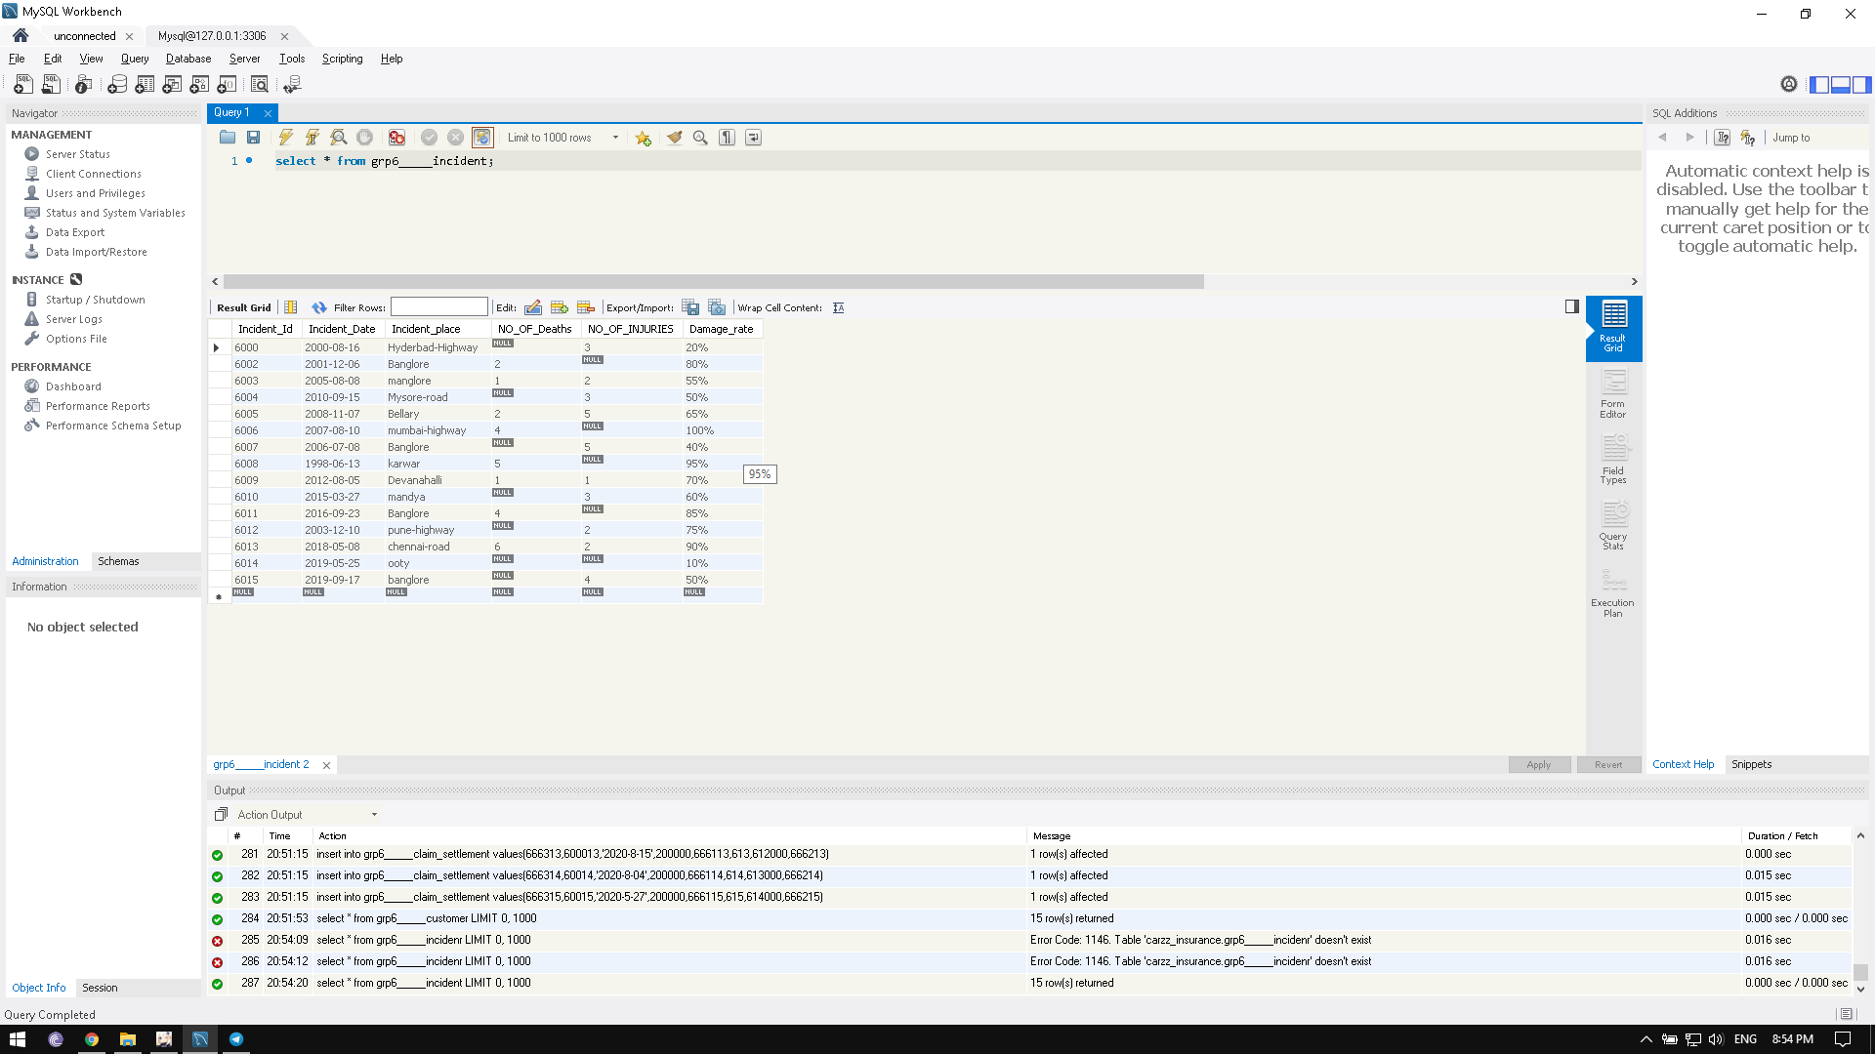
INCIDENT DATABASE

Slide 16
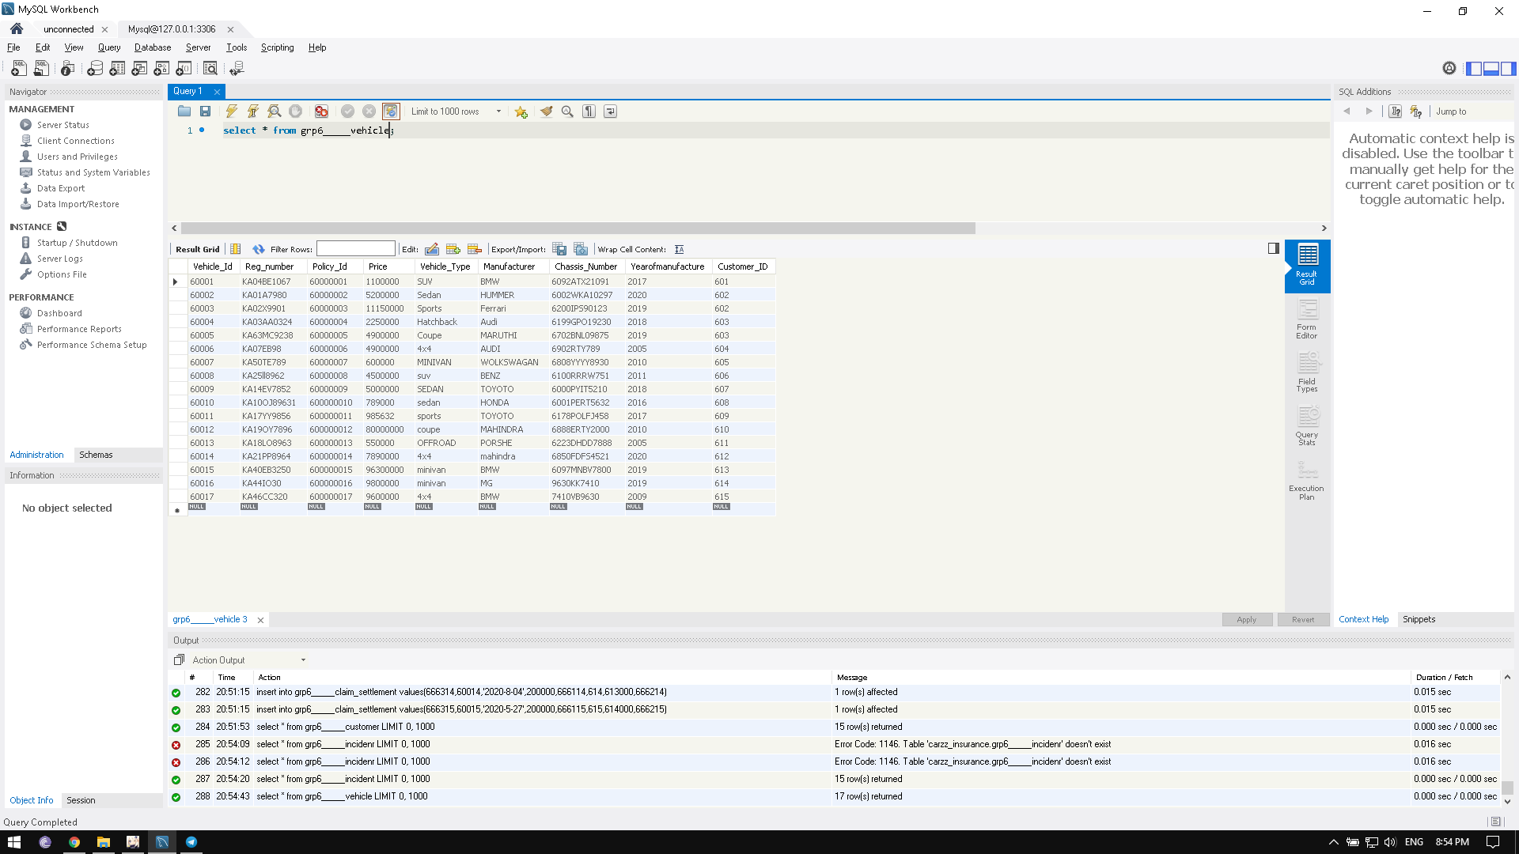
VEHICLE DATABASE

